Slide 1
Hands On DataScience
Oriol Varela

Slide 2
Index
What is Data Science?
Machine learning introduction
Hands on coding
Conclusions

Slide 3
What is Data Science?

Slide 4
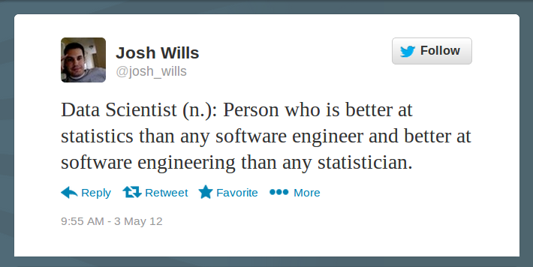

Slide 5
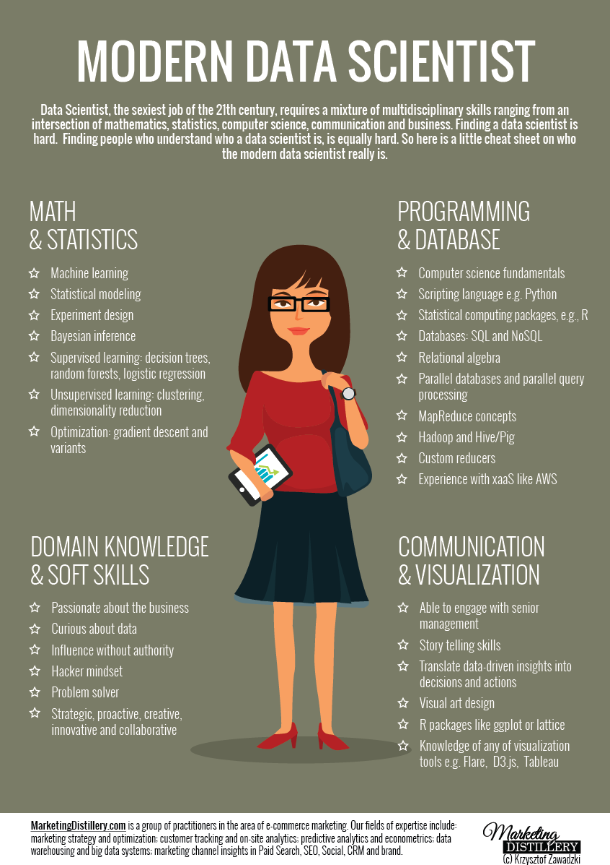

Slide 6
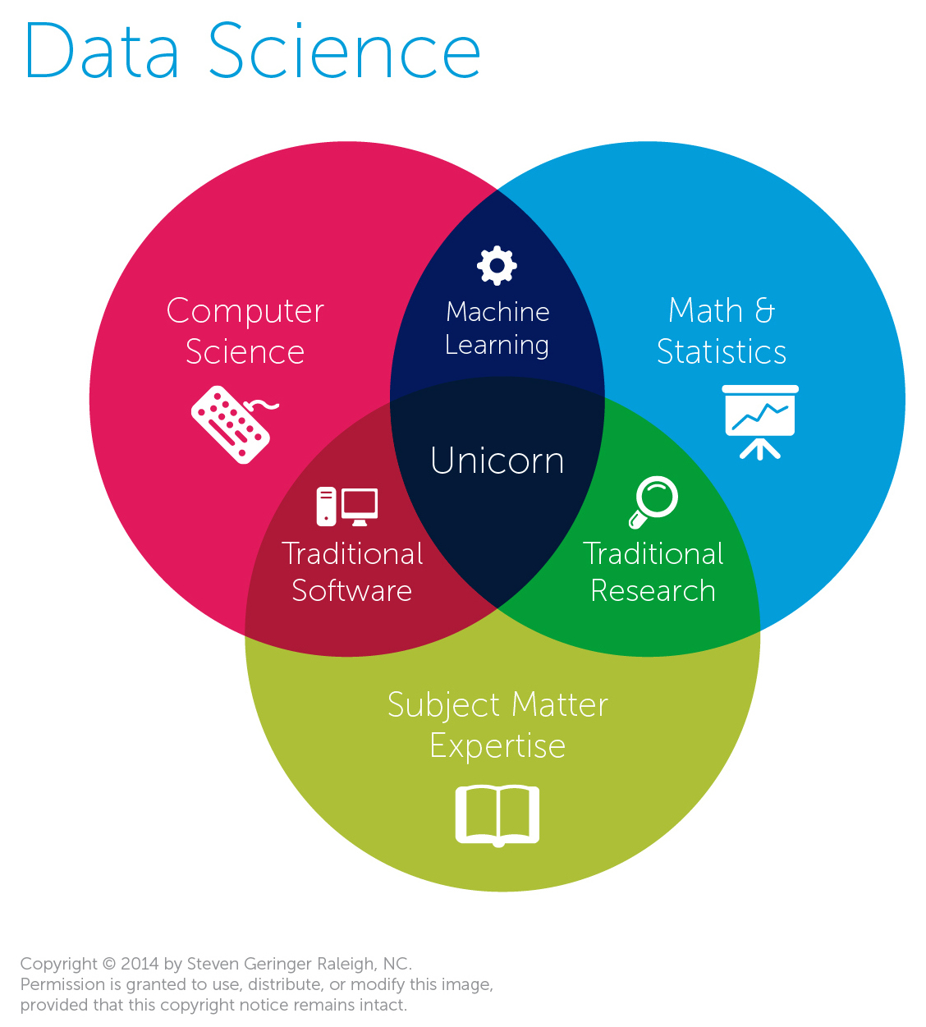

Slide 7
What is Data Science?
Data science is the process/science/magic of turning raw data into useful information.
Ask the right question.
Be sure you have the correct data to answer it.

Slide 8
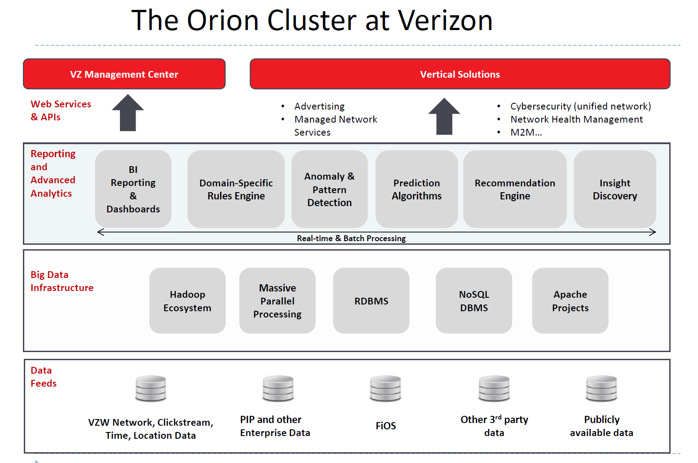

Slide 9
WHAT IS MACHINE LEARNING ?
Traditional programming
Computer
Data
Output
Algorithm

Slide 10
WHAT IS MACHINE LEARNING ?
Machine learning
Computer
Data
Algorithm
Output

Slide 11
The 5 questions that Data Science can answer
Is this A or B?
How much or how many?
Is this weird?
How is this data organized?
What should I do next?

Slide 12
1 – Classification
Looks at previous data and classifies unknown data into the most likely group.
Examples:
Is this production line going to break? (Yes/No)
What bring more customers, 5% discount card or $10 discount bonus. (Group A or B)
Also Multiclass classification, more than 2 possible groups to be classified. Is this A or B or C or D… Can be up to thousands/millions

Slide 13
2 - Regression
Numerical predictions.
Examples:
What are my sales in the 3rd quarter going to be?
How much can I sale my house for next year?
How many ads can I show next months?

Slide 14
3 – Anomaly detection
Recognizes estrange behaviors, analyzes patterns
Example we all use. Credit cards:
Your pattern behavior is analyzed and you might get an alert if something weird is detected. For example shopping in different locations. Buying more expensive things than usual.
Preventing internet attacks, cyber security.

Slide 15
4 – Clustering
You don’t have previous information about the data. Want to get insight from it.
Separates data in similar groups (clusters). For easier interpretation.
Extract rules from it. People who bought product A are also likely to buy product B
Examples:
Which viewers like the same type of movies?
Which printers/ smartphones/whatever fail in the same way
If you understand how your data is organized you can better make predictions, classifications and extract useful information from it.

Slide 16
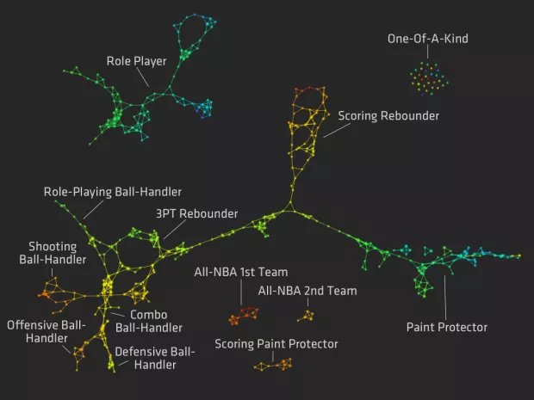
Notes:
https://flowingdata.com/2012/03/21/redefining-nba-basketball-positions/

Slide 17
5 – Reinforcement learning
Inspired on behaviorist psychology.
Learn from outcomes to decide for the next action.
Examples:
Self driving car. Keep accelerating or brake?
Vacuum robot: Keep vacuum? Stop? Go charge?

Slide 18


Slide 19

To the code!

Slide 20
Overfitting
The model overperforms with the trained data but when getting into unknown data the results are lower than expected.

Slide 21
K – Fold Cross Validation
splitting the full dataset into k equal length partitions,
selecting k-1 partitions as the training set and
selecting the remaining partition as the test set
training the model on the training set,
using the trained model to predict labels on the test set,
computing an error metric (e.g. simple accuracy) and setting aside the value for later,
repeating all of the above steps k-1 times, until each partition has been used as the test set for an iteration,
calculating the mean of the k error values.

Slide 22
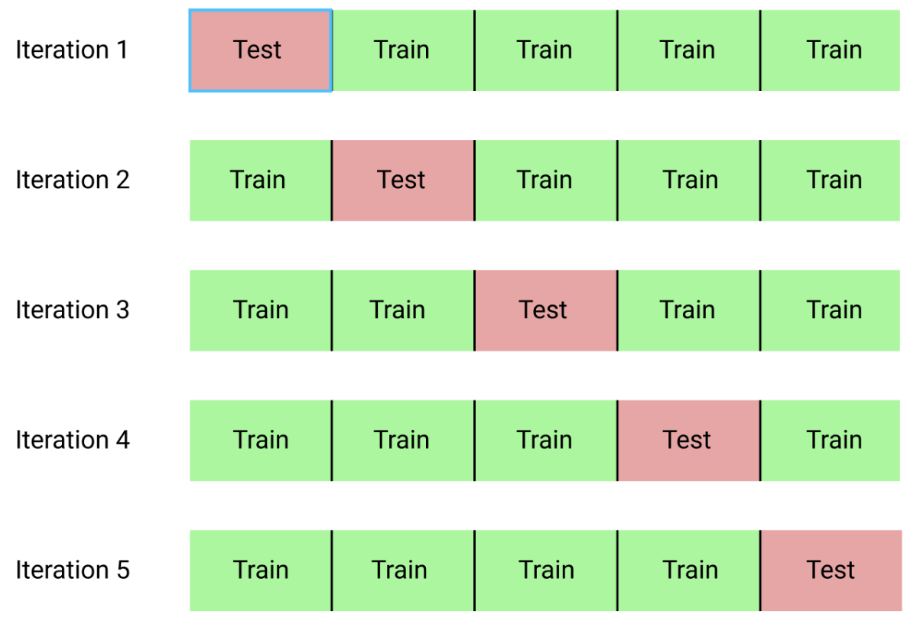
K – Fold Cross Validation

Slide 23
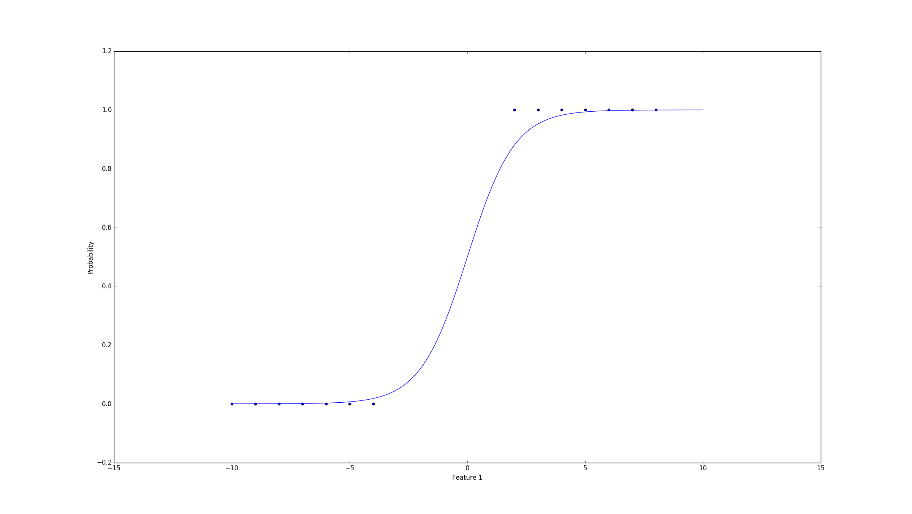
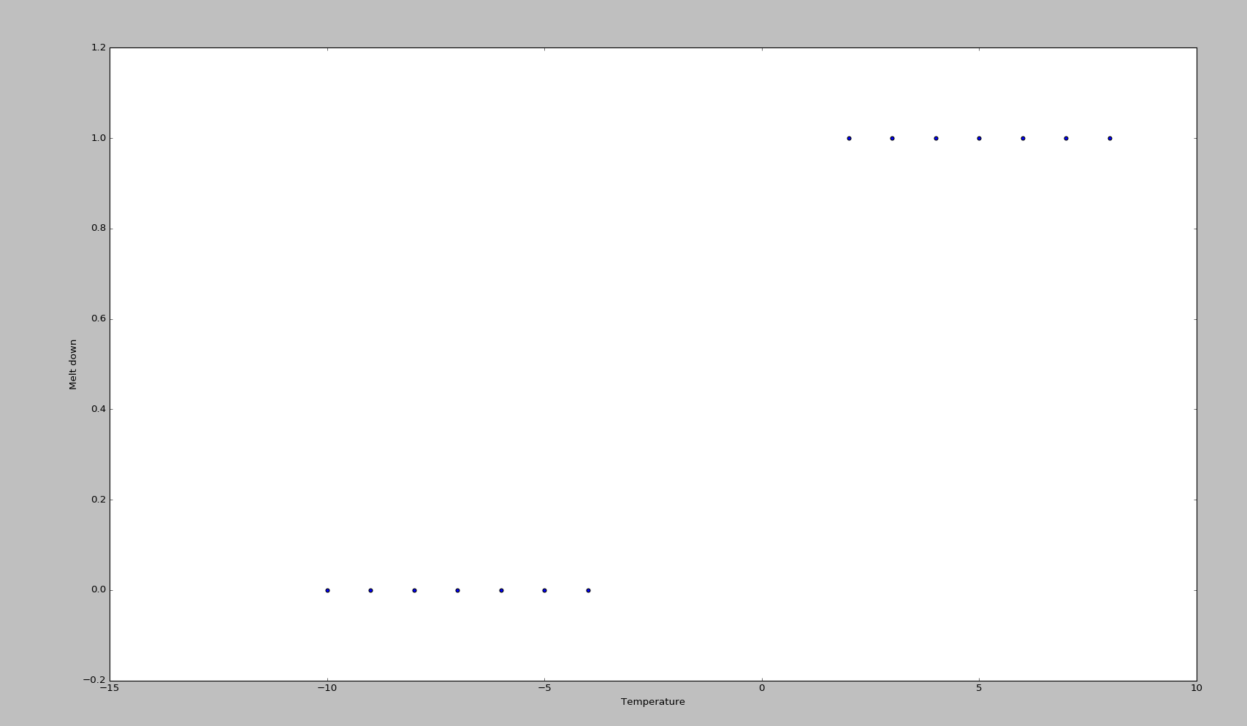
Logistic Regression

Slide 24
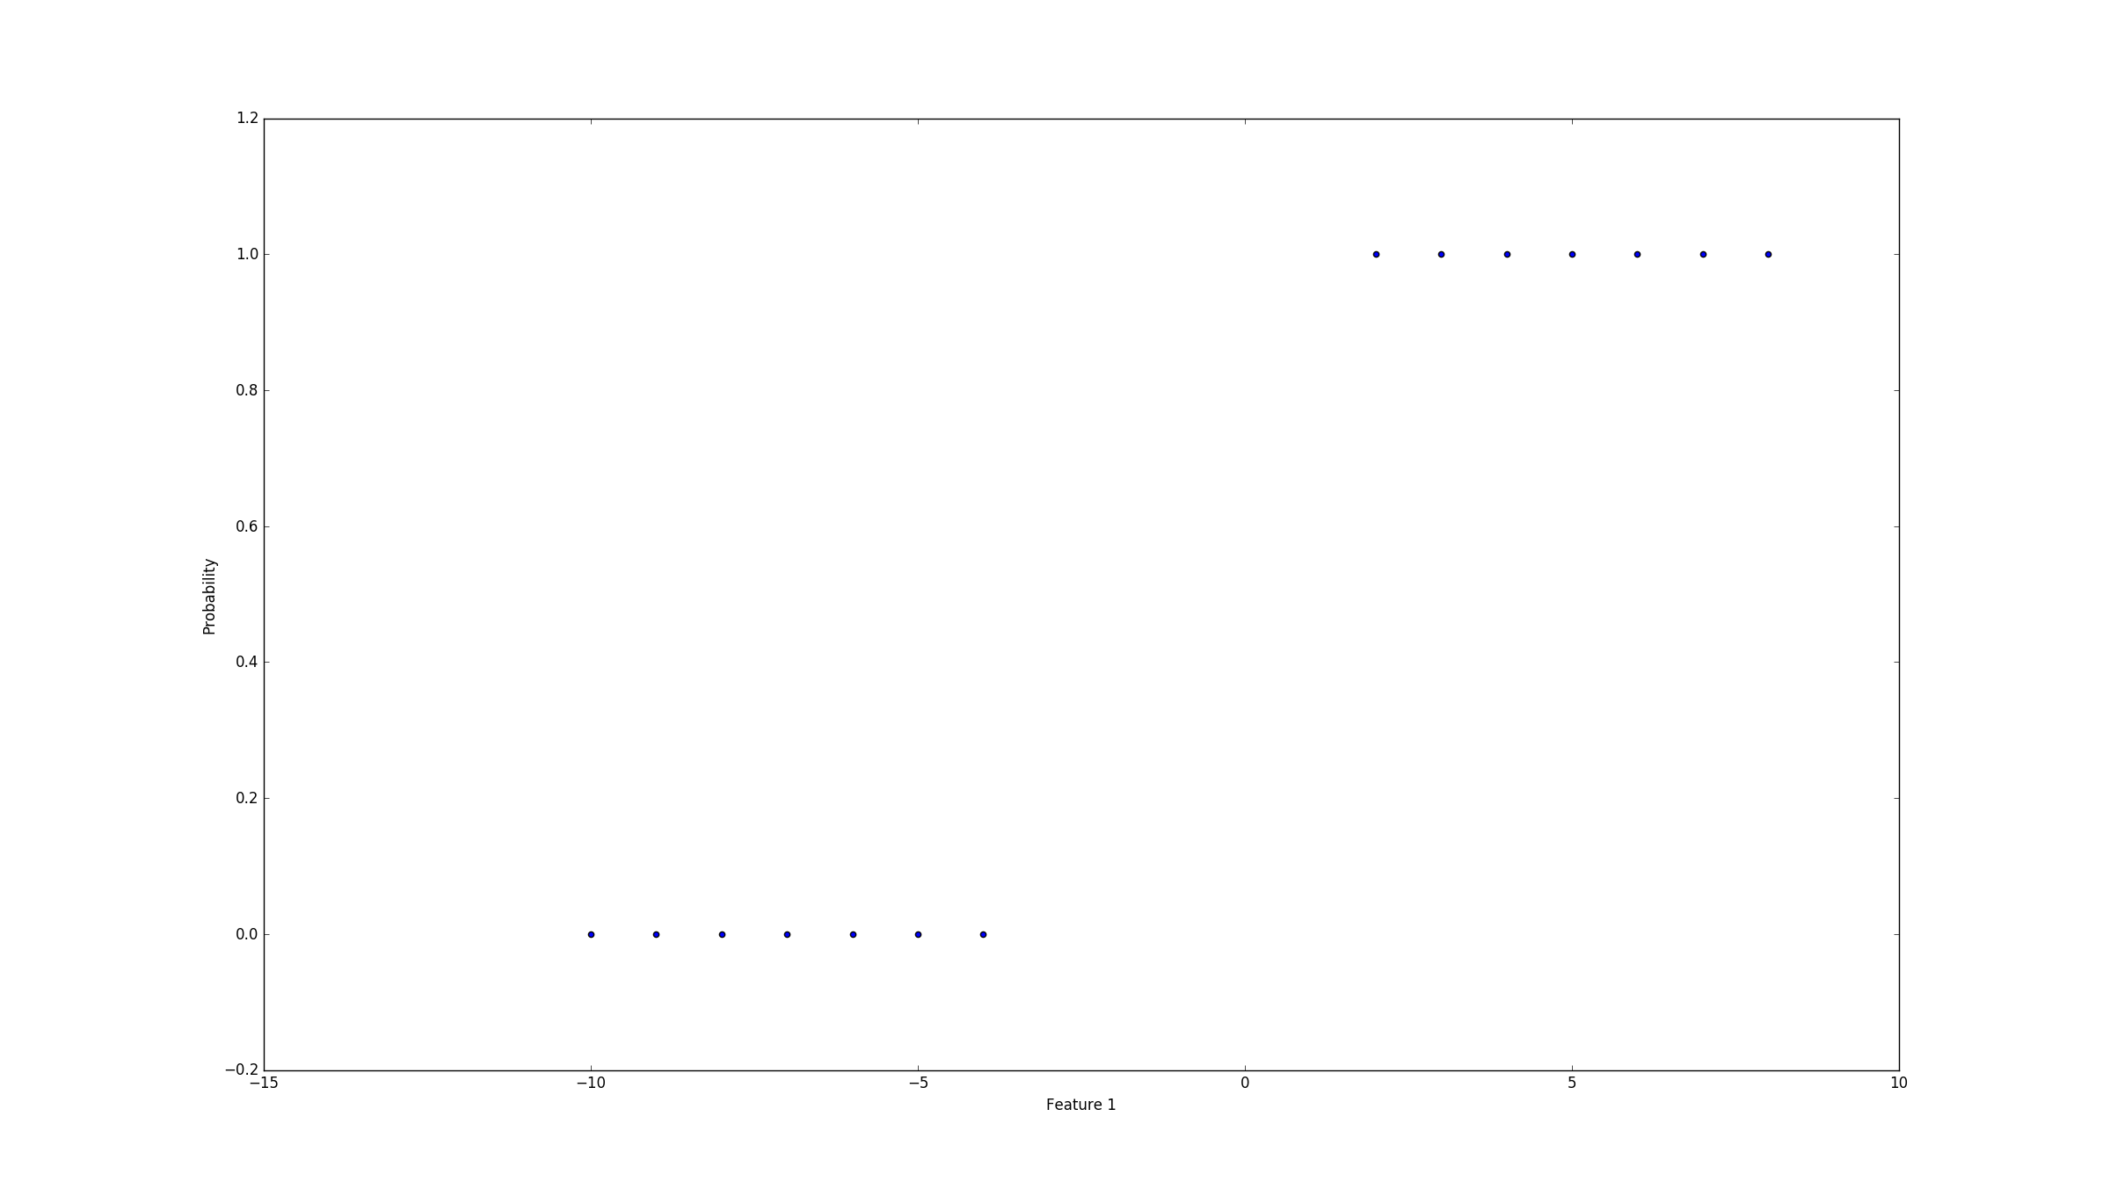
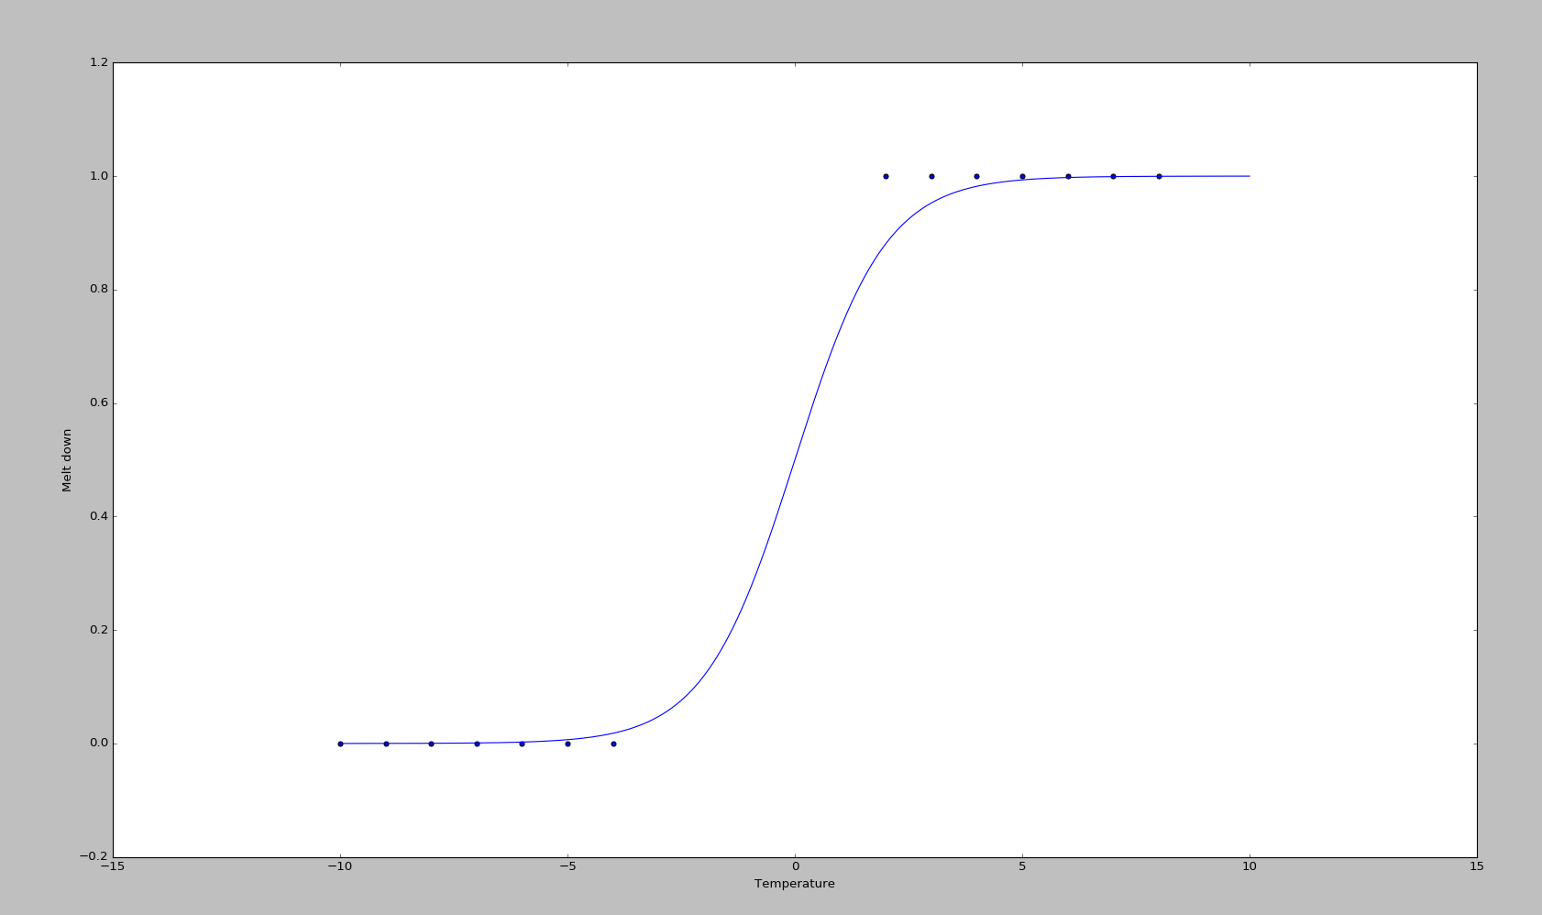
Logistic Regression

Slide 25
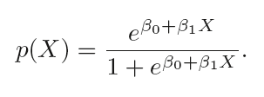
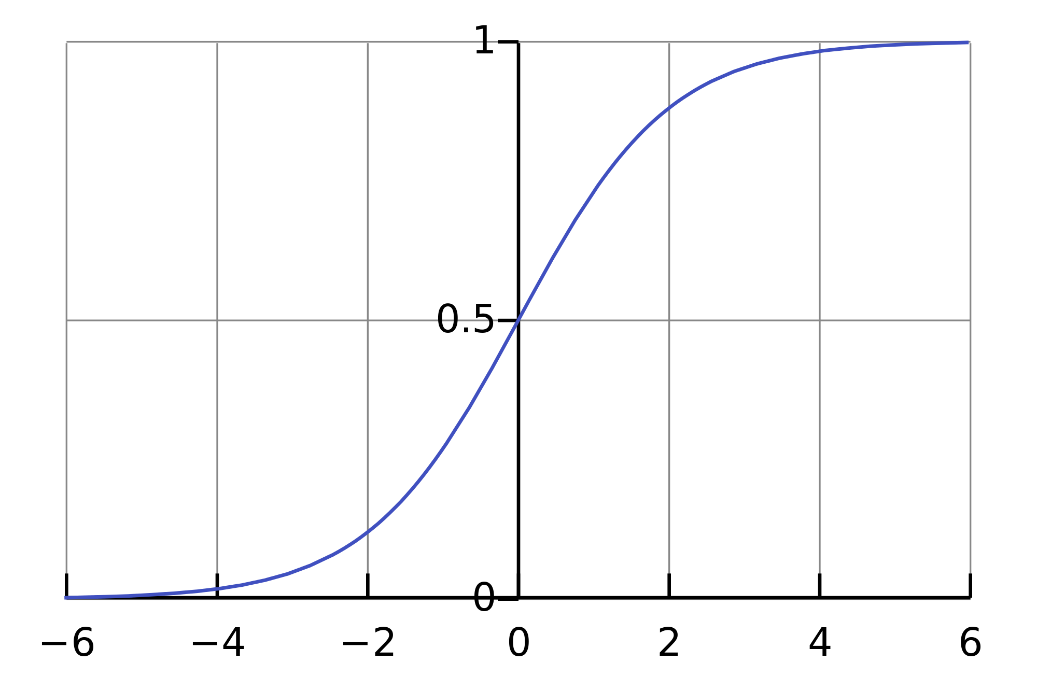
Logistic Regression

Slide 26
Logistic Regression
If you want to more about how to model a logistic regression:
Maximum likelihood
Newton-Raphson Method

Slide 27
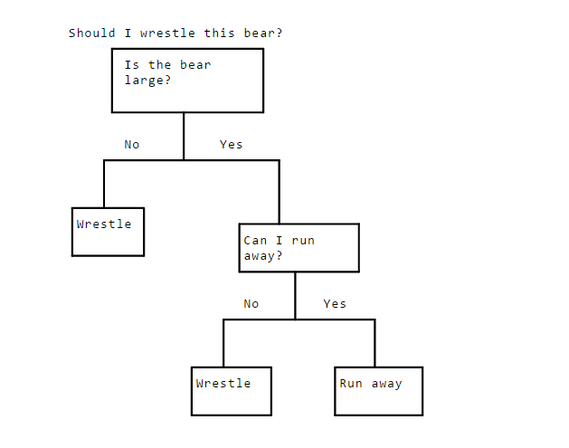
Logistic Regression
Decision trees
Notes:
Decision trees can pick up nonlinear tendencies in the data. The idea behing a decision tree is that we split our data until we'll eventually reach a leaf. The leaf will tell us what value we should predict for. That leaf should be either 1 or 0, we keep splitting until we reach that point

Slide 28
Logistic Regression
How do we programatically know how to split?
We're trying to get to leaves consisting of only 1s or only 0s, each split will need to get us closer to that goal.
When we split, we'll try to separate as many 0s from 1s in the target column as we can. In order to do this, we need a metric for how "together" the different values in the target column are.

Slide 29
Logistic Regression
How do we programatically know how to split?
Mathematics! Entropy! Awesomeness
Entropy refers to disorder. The more "mixed together" 1s and 0s are, the higher the entropy. A dataset consisting of only 1s in the target column would have low entropy.
Entropy comes from information theory. (NOT PHYSICS!)
Notes:
Entropy can also be thought of in terms of information. If we flip a coin where both sides are heads, we know upfront that the result will be heads. Thus, we gain no new information by flipping the coin, so entropy is 0. On the other hand, if the coin has a heads side and a tails side, there's a 50% probability of landing on either. Thus, flipping the coin gives us one bit of information -- which side the coin landed on.

Slide 30
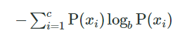
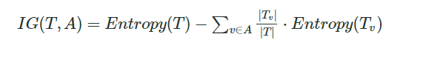
Logistic Regression
How do we programatically know how to split?
Notes:
Basically what we are trying to do is to lower the entropy. We're finding the entropy of each set post-split, weighting it by the number of items in each split, then subtracting from the current entropy. If it's positive, we've lowered entropy with our split. The higher it is, the more we've lowered entropy.

Slide 31
Logistic Regression
Now we can understand random forests:
The problem with decision trees is the overfitting. They perform very good for the train data but not when testing with unknown data.
A random forests is an ensemble model. It combines the predictions of multiple models to create a more accurate final prediction.

Slide 32

Logistic Regression

Slide 33
Logistic Regression
What we are basically doing is building different decision trees:
Different parameters, leafs, max depth…
Different training data (bagging)
Different splitting methods
- All combined gives a better result. On the other hand it takes more time to train. And it is more expensive to compute
Notes:
Let’s say we have two programmers with different backgrounds. If you give both of them a project, since they both have different knowledge and experience, they'll both approach it in slightly different ways. They may both produce code that achieves the same result, but one may run faster in certain areas. The other may have a better interface. Even though both of them have about the same talent level, because they approach the problem differently, their solutions are stronger in different areas. If we combine the best parts of both of their projects, we'll end up with a stronger combined project.

